Slide 1
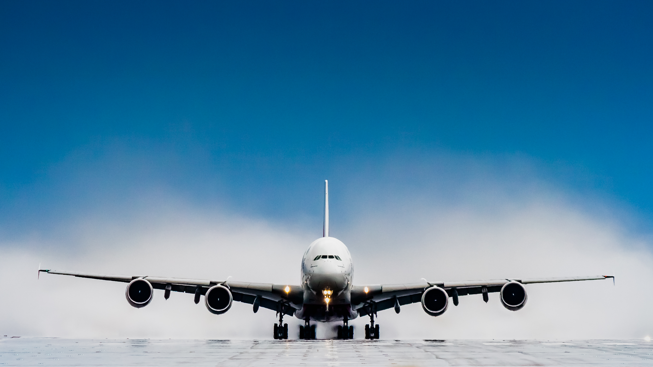
Prediction of Flight Status in Top 25 Busiest domestic routes of US

Slide 2
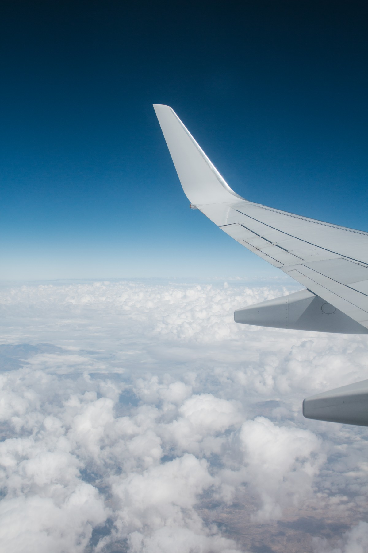

SINDHURA.A
MITHIL.S
MEDHA.A
RAVINDRA.V
SUDROSH.A
SANJANA.T

Slide 3

Business problem
Building a model that predicts delays and cancellations is advantageous to both airline carriers and their customers.
Airlines can utilize such models to cut down costs (crew, maintenance, fuel and other) as a result of possible delays and offer better service to passengers or reschedule the flights to avoid such events.
Such model can also be utilized to increase revenue by offering better services during times where there are most delays or cancellations from competitors.
Since flight delays/cancellations has a significant negative impact on the customer and air carrier relationship, an updated notice of a flight's departure and arrival times compared to its scheduled times gives travelers time to prepare for possible delays or making quick decisions and schedule their travel in case of emergency.
The purpose of our project is to look at the approaches to build models for predicting the possible delays and cancellations of flights in top 25 Busiest routes of US.
Factors considered for the analysis includes Holidays, trends of delays/cancellations occurred in past week and past month, Seasons, Air traffic of origin and destinations are very crucial for our model.

Slide 4
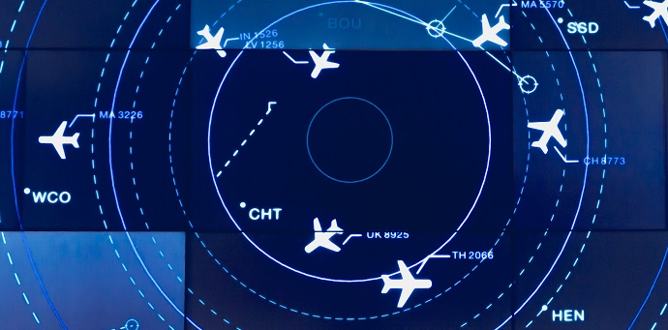
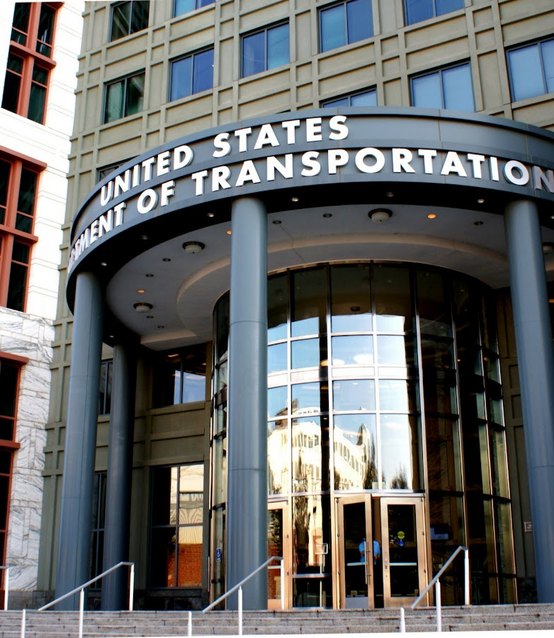
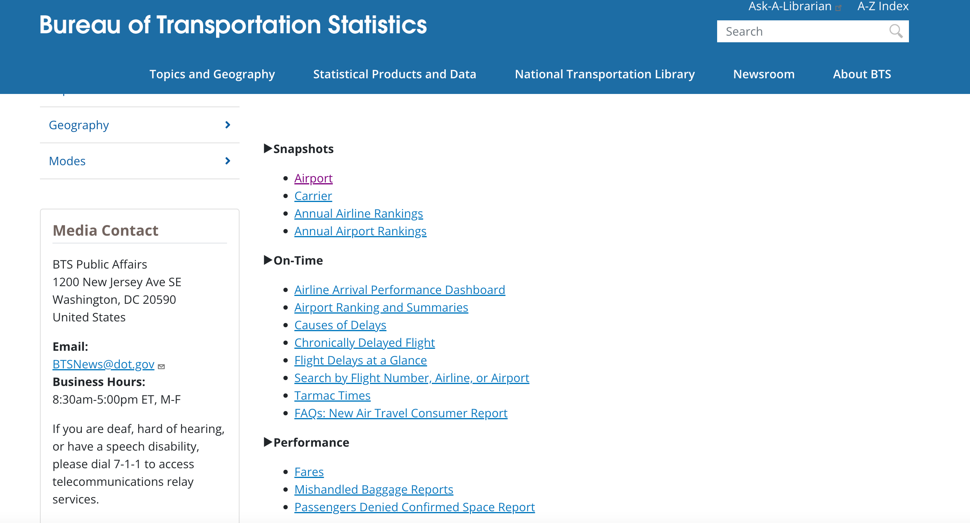
SOLUTIONS IMPLEMENTED
The U.S. Department of Transportation has created a dashboard named Bureau of Transportation statistic’s which comprises of airline, Flights, Passenger complaints, causes of delays, Performance, Airport rankings and summary , Rural airports and many other.
This is accessible to the public where the individual flight status /unknown airport parameters could be understood for a common man.

Slide 5

DATA SET DETAILS
Original data source has vast source of information on various transport statistics. For the purpose of this project Marketing Carrier On-Time Performance dataset is being used.
Dataset contains arrival and departure data for non-stop US domestic flights.
Only includes US certified air carriers that account for at least one percent of domestic scheduled passenger revenues.
Includes detailed data on airlines, origin, destination, schedules times, delays, information related to delays and all diversions from origin to destination.
Dataset update frequency is on monthly basis with a lag of one month.
At the time of our selection, latest available data is August 2022.
Office of airline information, Bureau of Transportation statistics is responsible for collection of data.
Data source link https://www.transtats.bts.gov/TableInfo.asp

Slide 6



ANALySIS
This Photo by Unknown Author is licensed under CC BY
This Photo by Unknown Author is licensed under CC BY

Slide 7

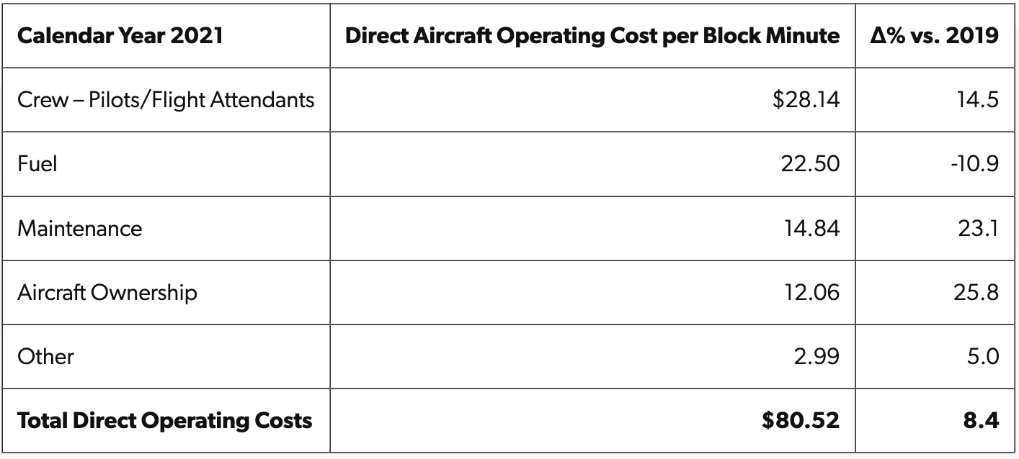
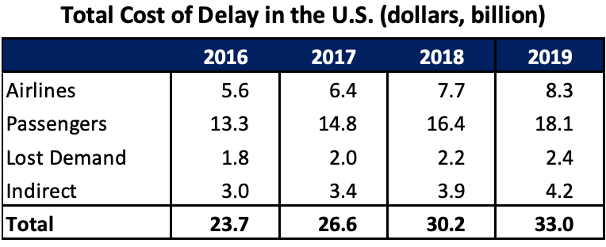
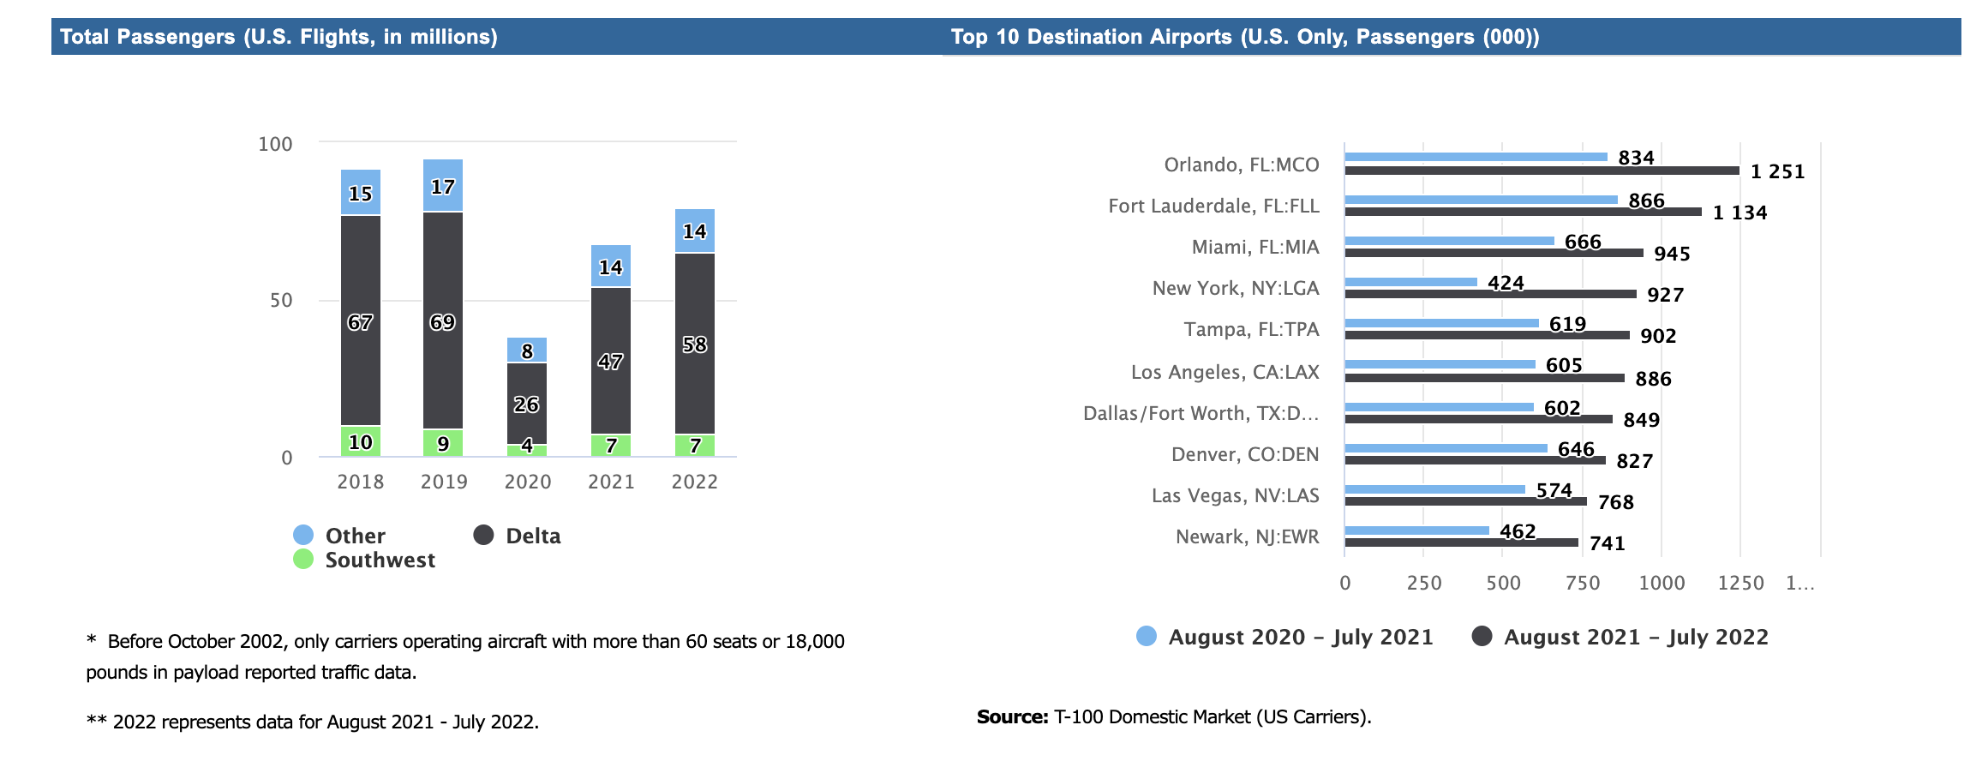
Delay cost ESTIMATES
In 2021, the average cost of aircraft block (taxi plus airborne) time for U.S. passenger airlines was $80.52 per minute
Average delay: 12.4 minutes
Cost per minute: $74,20 USD
Average number of delayed flights per month: 34.9

Slide 8
BUSIEST AIRPORTS

Slide 9
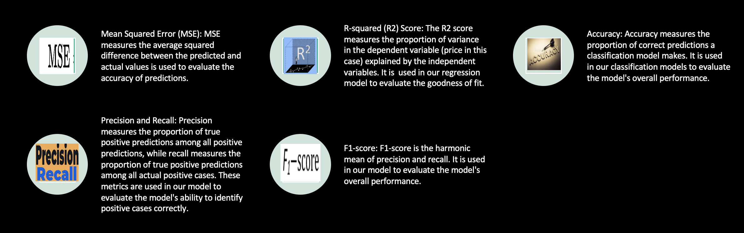
Evaluation of our Solution

Slide 10
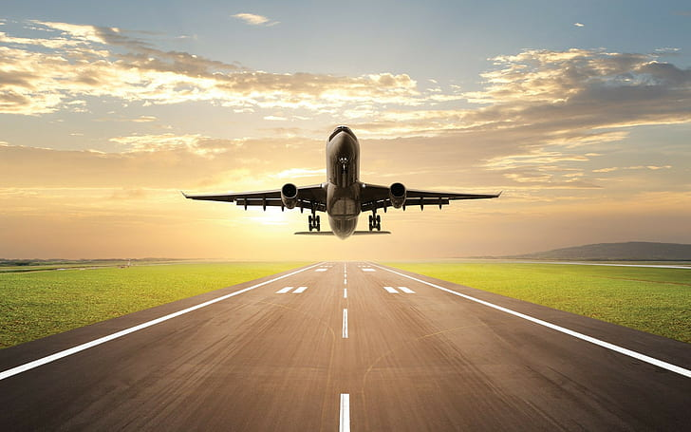
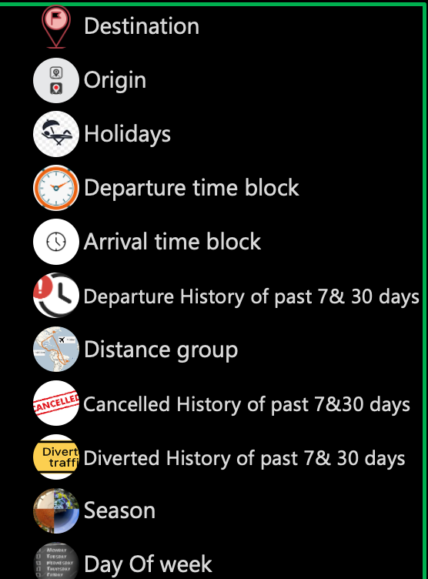

SELECTION OF PREDICTORS

Slide 11
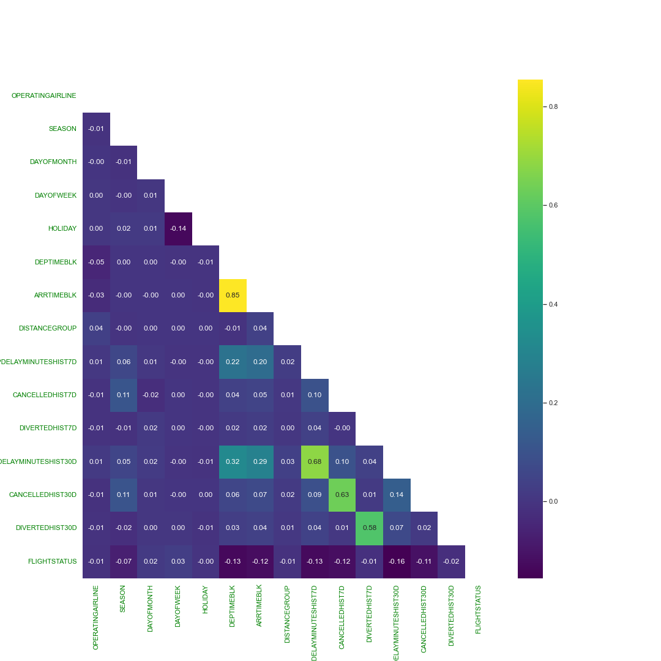
Correlations
Correlation across different features indicated that flights leaving end of the day or winter seasons are most likely to get cancelled or delayed compared to rest.
Also, higher the historical delays or cancellations, higher the chance that the flight from same airline leaving from same origin airport could get delayed or cancelled.
We believe above correlations are valid intuitively and explains practical scenarios in day-to-day travel.

Slide 12
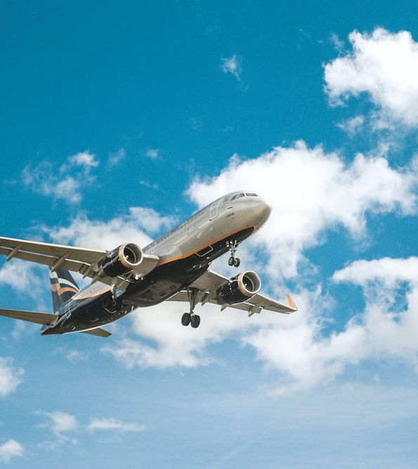
OUR MODEL Importance
Air traffic flow has experienced rapid growth in recent years, which brings predicting flight status would be a great source of information for passengers.
We synopsized various factors which may potentially influence the flight status. In addition, we have added Holidays and Seasons as our variables to verify if there is an impact on flight status. Thus, we obtain an integral dataset where we could deal with delays, Seasons, Cancelations and Holidays.
Several machine learning based-network architectures are proposed on this aviation dataset, mostly focused on air traffic, type of delays, cost impact of delays, single route or airport. However,
Our work deals with the top 25 busiest airports considering various factors such as seasons, Historical trend of delays, cancellations and diversions
WHO COULD USE OUR MODEL : Analysts of airline carries could use this model to improve their customer satisfaction, reduce the costs associated with the delays.

Slide 13
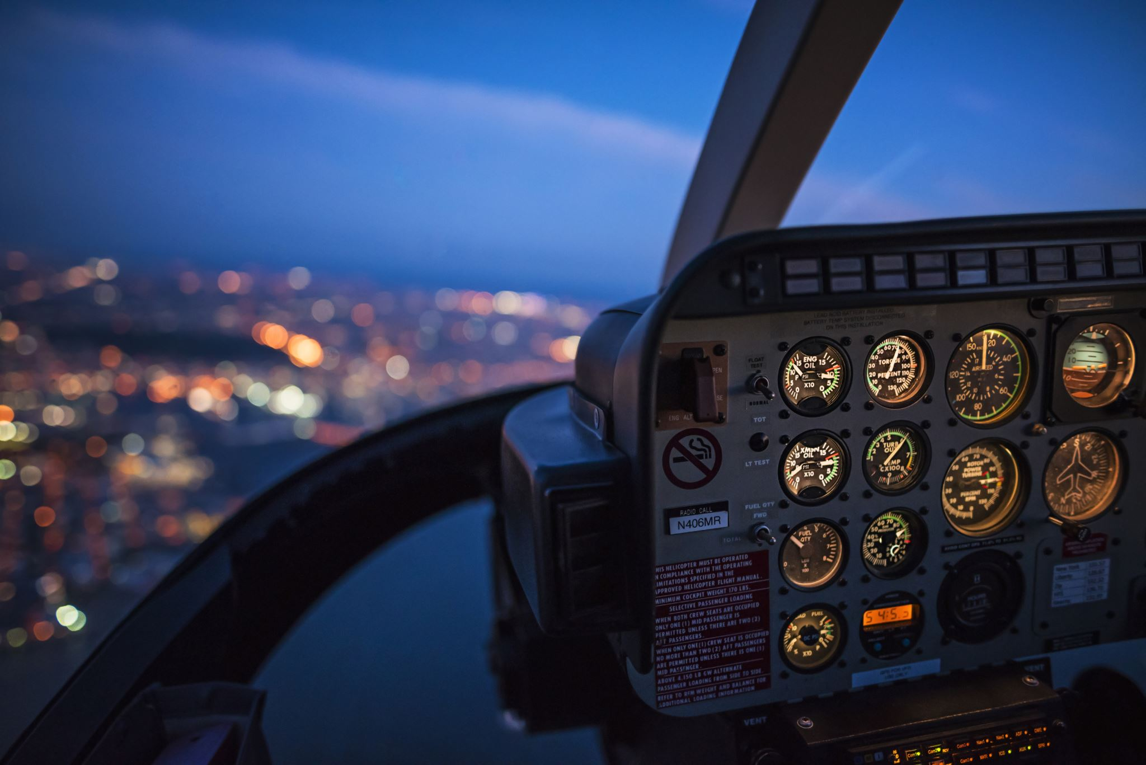
MORE ABOUT TARGET
Prediction of Flight status is our target variable
Four classes were identified i.e., Cancelled, Short Delay, Long Delay On Time making this a multi-class problem.
To better understand implications of good and bad predictions, it’s important to look from business perspective which are reiterated below
Utilize model predictions to cut-down costs by pre-planning for possible delays/cancellations.
Provide better service to passengers.
Offer better services than competitors during times when competitors have most delays/cancellations, source for higher revenue generation.
True positive – predicting flight as on-time when they are on-time.
No negative implications, provides better service to passengers.
False positive - predicting flight as on-time when they are in fact delayed or cancelled.
Increases costs because of lack of pre-planning for delays
Decreases passengers' confidence on the service.
True negative – predicting flight as delayed/cancelled when they are delayed/cancelled.
Better pre-planning for delays/cancellations
False negative - predicting flight as delayed/cancelled when they are in fact on-time.
Airline using information to provide better service compared to competitors will increase costs rather than generating higher revenue.
Significant negative impact on passengers’ confidence along with increased costs of refunds.

Slide 14
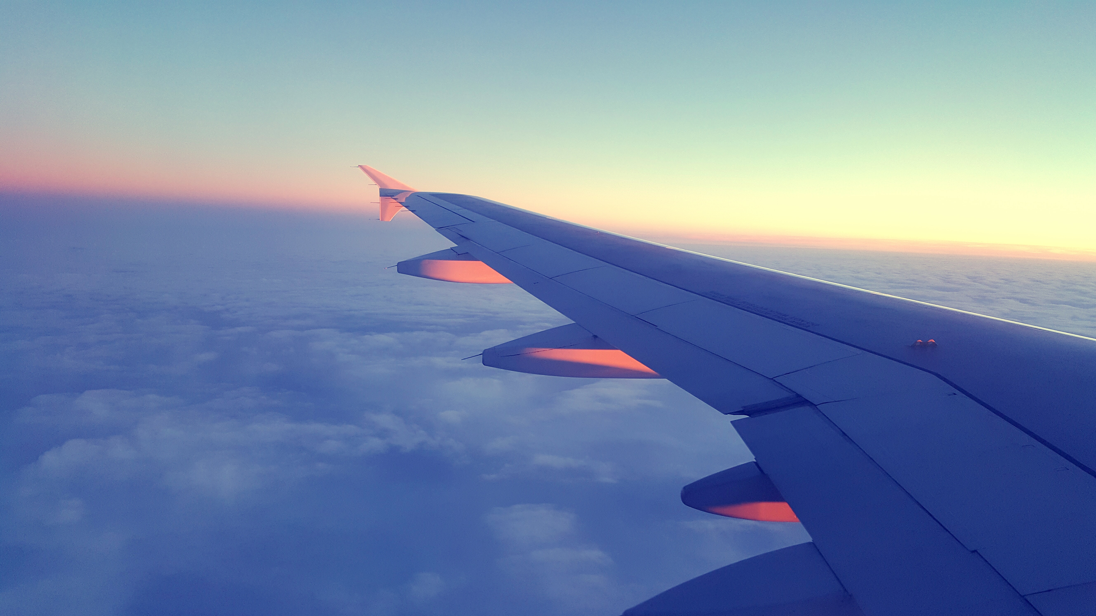
SCORING METRIC
False Positive - predicting flight as on-time when they are in fact delayed or cancelled.
Increases costs because of lack of pre-planning for delays
Decreases passengers' confidence on the service.
False Negative - predicting flight as delayed/cancelled when they are in fact on-time.
Airline using information to provide better service compared to competitors will increase costs rather than generating higher revenue because of costs associated with pre planning for delays.
Significant negative impact on passengers’ confidence along with increased costs of refunds.
FALSE POSITIVE
FALSE
NEGATIVE
Summary
The above two cases are considered important as they decide customer satisfaction and feedback, Airline reputation and revenue.
Based on analysis, we believe false negative and false positive far out-weigh true implications.
False positives and False negatives should be minimal. This further indicates that model should give equal importance to precision and recall which is embedded in f1-score.
F1 score is considered besides accuracy as our score metric since we have an imbalanced dataset.
Hence for this analysis, we plan to proceed with f1-score as our scoring metric.

Slide 15


PROCESS
Train-test random split
Preliminary exploratory analysis on raw data
Pre-processing/cleaning/loading
Filter raw data for 25 busiest domestic routes
Train models to find best fit
Test models on out of sample data
Merge monthly raw data
Add historical trends, seasons, holidays

Slide 16
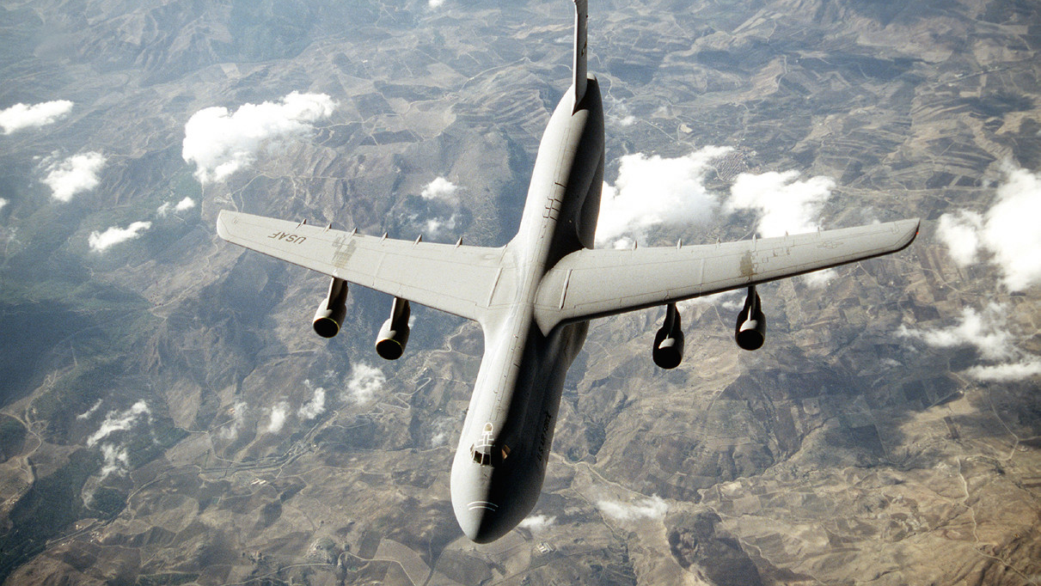
MODELS USED FOR ANALYSIS
KNN
XG Boost
Decision tree
Random Forest
MLP classifier
ADA Boost
Gradient Boost
This Photo by Unknown Author is licensed under CC BY-SA

Slide 17

MODEL RESULTS
As far as the F1 score results are concerned all classifiers have predicted almost the same, considering time factor complexities Gradient boost performed well.

Slide 18

conclusions

Slide 19

Enormous growth in air traffic has also led to significant rise in delay costs for the airlines as detailed previously.
Bureau of transportation provides detailed data on all domestic airlines that would help in understanding the intricacies of reasons for delays.
Our analysis was to understand whether we can predict flight delays/cancellations thus further helping airline service providers and passengers.
Airlines can take advantage of such models to reduce costs by pre-planning and explore possibilities for revenue generation by providing better competing services.
Passengers can use the same information to avoid inconveniences or change plans accordingly.
As outlined earlier, we believe false positives and negatives were equally important for the model to minimize.
We have utilized the data to train different classification models. While the purpose of the analysis was to find a best effective model, we noticed that different classification models were able to perform on par with each other while Random Forest is slightly better than the rest.
In conclusion, any of the trained models can be utilized by airlines to improve their services.

Slide 20

FURTHER ENHANCEMENTS
We have chosen only busiest 25 airports we could extend this model to various airports
Types of delays classification could be done with this model if we could replace the historical departure delays with historical delays for specific category (carrier delay, weather delay, NAS delay, Security delay, Late Aircraft delay).
In our preliminary analysis, we noticed that carrier delays accounts for almost 25% of delays. Hence individual airlines can use detailed information they have on record for carrier delays and enhance models
Depending on airport, some airports are often affected by weather. Weather information which is publicly available can be used to target and improve predictions on certain airports.
Model can be further expanded to use diversions data of the flight before reaching origin/destination airport
Instead of categorizing by airport, we could choose categorizing by city to broader scope.

Slide 21

REFERENCES
https://medium.com/airbnb-engineering/data-infrastructure-at-airbnb-8adfb34f169c

Slide 22

THANK YOU

